Slide 1
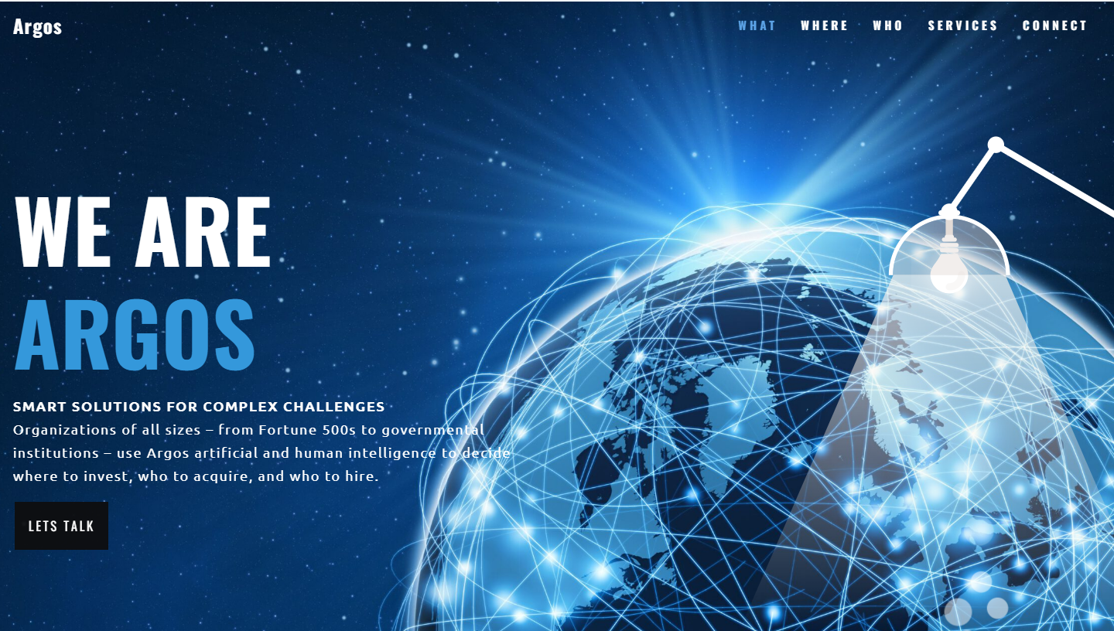

Slide 2
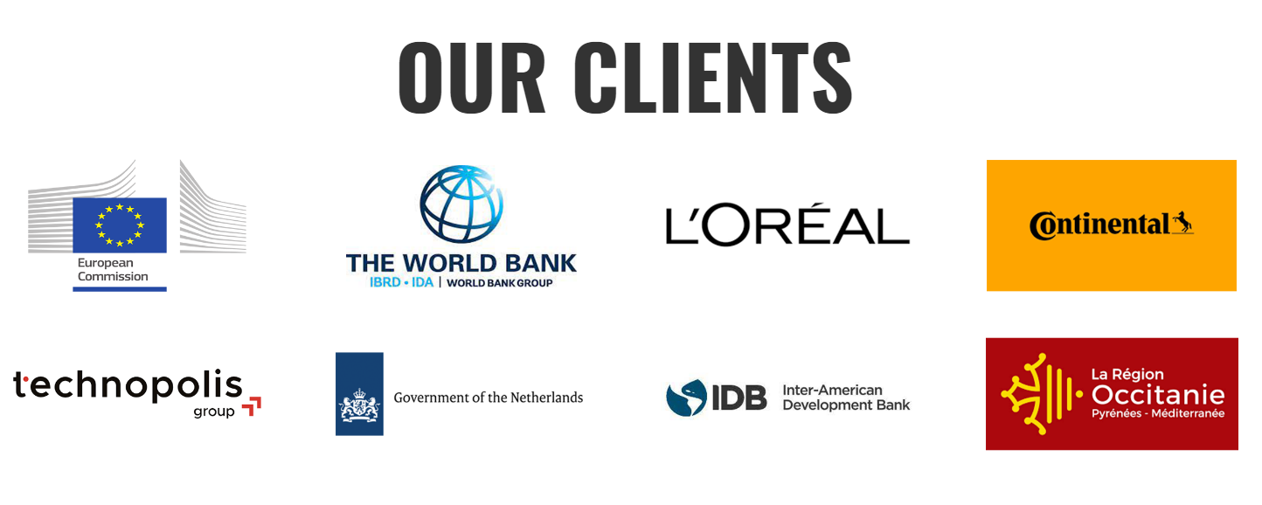




OUR CLIENTS

Slide 3
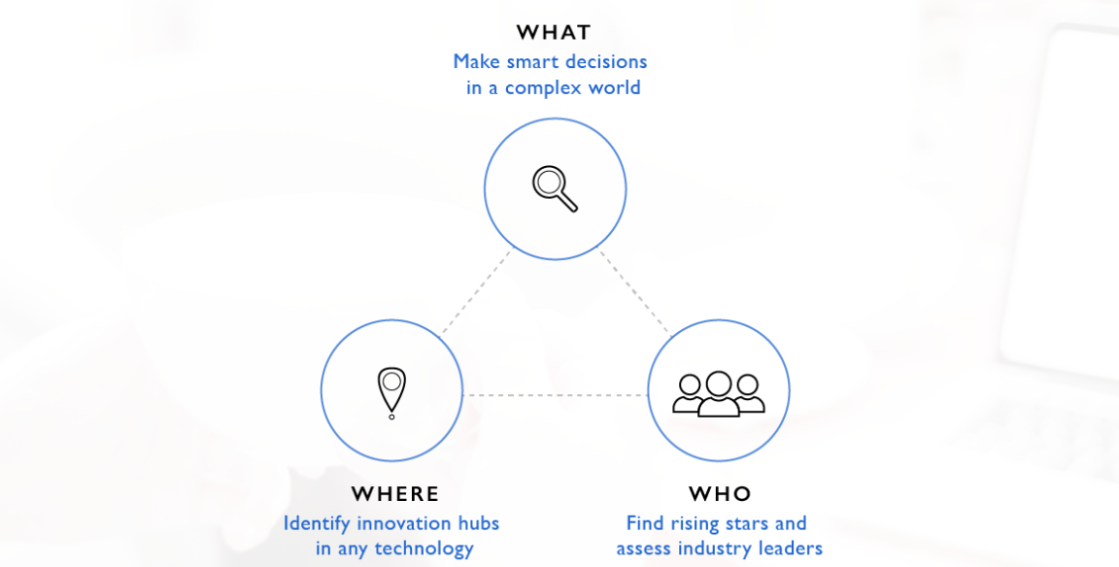
INNOVATION STRATEGY

Slide 4
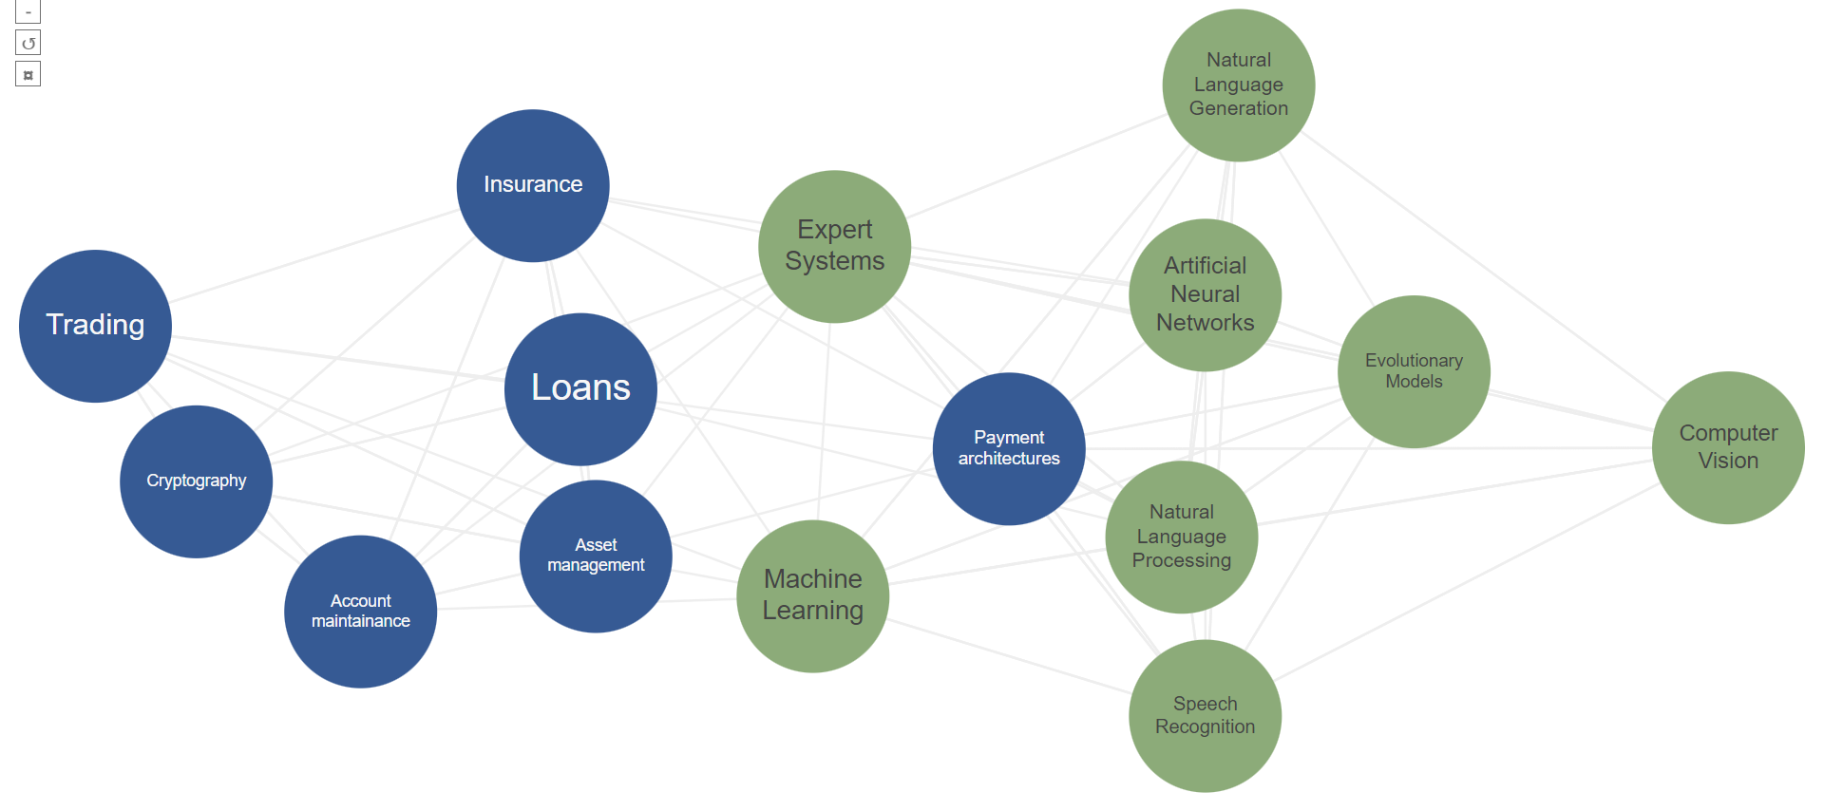
CASE STUDY: RE-INVENTING BANKING WITH AI
A client wants to invest in AI to re-invent its banking experience. We map how specific subfields of AI are actually powering banking applications so the client can make better data-driven investment decisions

Slide 5
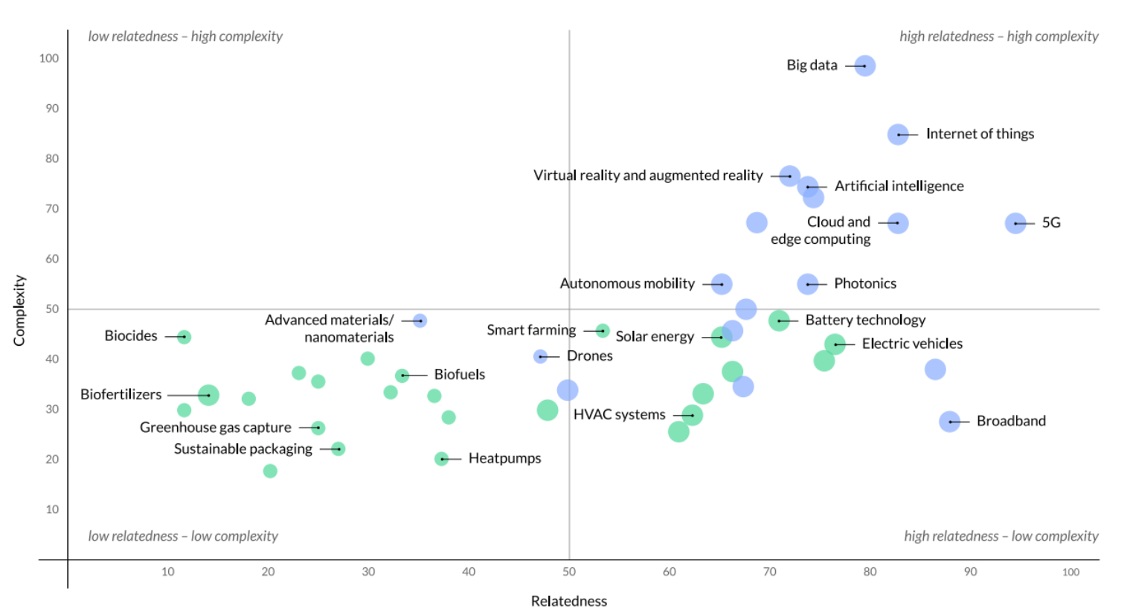
Measuring investment opportunities
A clients wants to invest in different new technologies – we evaluate feasibility (relatedness) and long-run value (complexity) to help prioritize investments in the right fields

Slide 6
INNOVATION STRATEGY

Slide 7
When it comes to cutting-edge innovation: location matters. We deploy machine learning tools and scan billions of data points, so our clients don’t have to guess where to locate their R&D lab, incubator or offices.

Slide 8
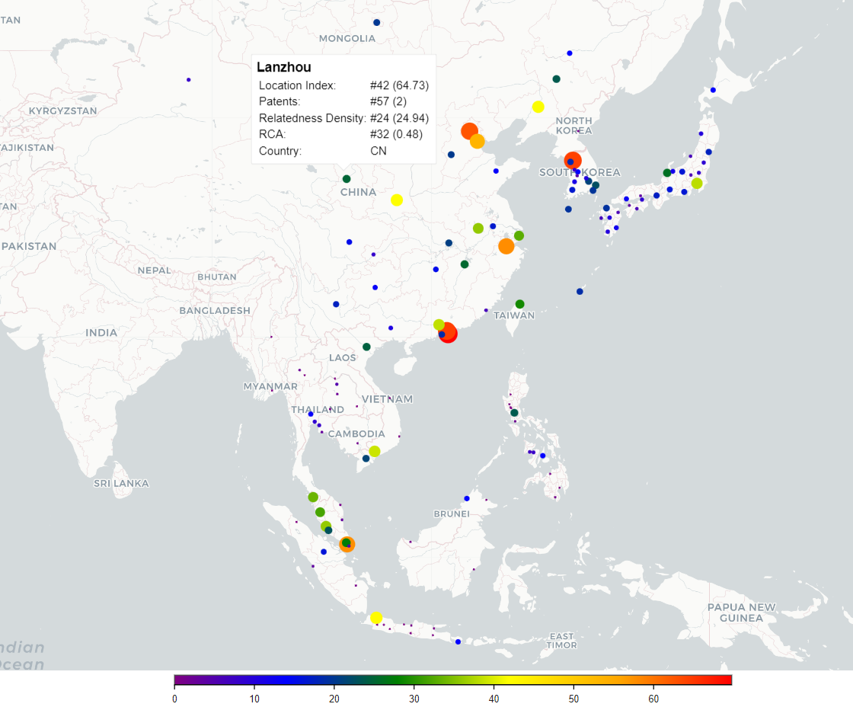
Locate where knowledge is
We help clients identify the ideal eco-system for R&D labs in very specific technologies. The right location is not always home but always depends on the technology!

Slide 9
INNOVATION STRATEGY

Slide 10
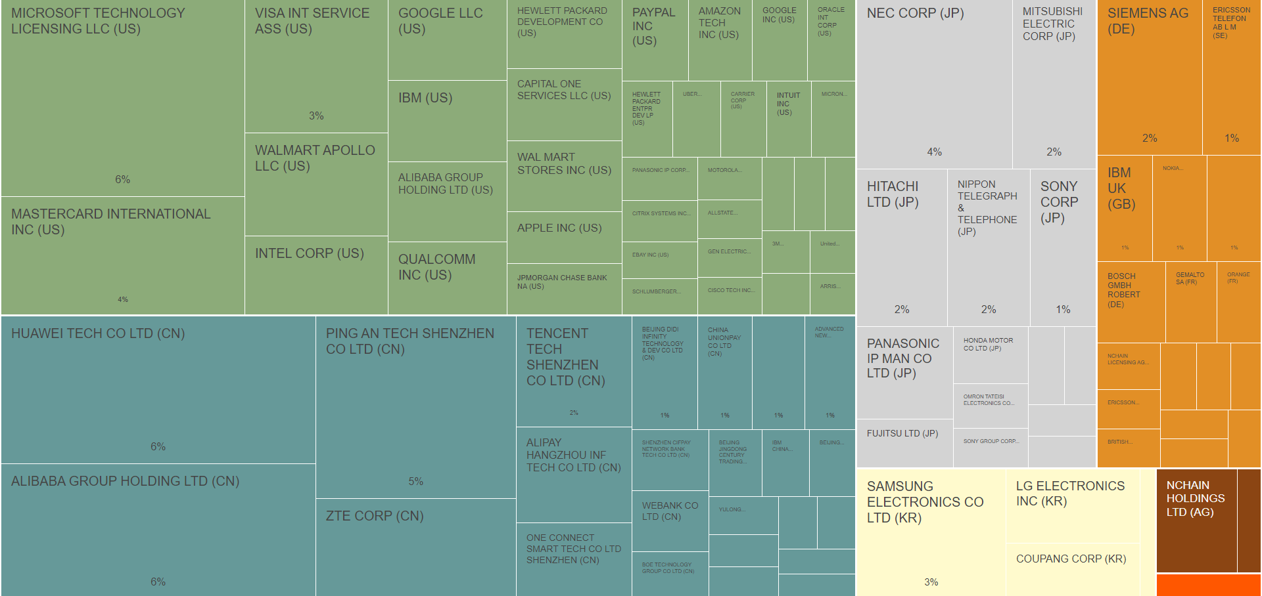
Who are the leaders in…ANY TECHNOLOGIES?
We help clients evaluate their position compared to the competition, suggest perfect matches for M&As and take talent acquisition to the next level by identifying the top inventors and scientists in any field
Notes:
FIND RISING STARS AND ASSESS INDUSTRY LEADERS
Global tech ecosystems are growing at an unprecedented rate. It is hard to assess who are the leaders you should connect to. Our data and models facilitate your competitive analysis, suggest perfect matches for M&A and take your talent acquisition to the next level.

Slide 11
